Slide 1

Multi Label Tweet
Classification and Applications
DEPARTMENT OF COMPUTER SCIENCE ENGINEERING & INFORMATION TECHNOLOGY
NOIDA INSTITUTE OF ENGINEERING & TECHNOLOGY, NOIDA
Enrollment No : 1613313117
Name : Vishesh Sharma
Supervisor : Mayank Deep Khare

Slide 2

Introduction
Social networking today has become a very popular communication tool among Internet users. Millions of users share opinions on different aspects of life every day. Social Networking web-sites become a valuable sources of people’s opinions and sentiments. Users tend to post about products and services they use, or express their political and religious views.

Slide 3


Why Twitter?
Twitter serves as a great place for social web mining because of its openness for public consumption, API documentation and ease of use, rich developer tool such as Twitter4J, and broad appeal to users from every walk of life. Twitter is chosen because it is predominantly suited for data mining because of three key features.
Twitter’s API is well designed and easy to access.
Twitter data is in a convenient format for analysis.
Twitter's terms of use for the data are relatively liberal as compared to other APIs .

Slide 4
Problem Statement
This project aims to extract the treasury of data obtained from micro-blogging site, Twitter, classify it and exploit its benefits. This Project tends to focus on the problem of classification, i.e., given a set of pre-determined classes, how to identify which classes an instance belongs to on the basis of both Sentiment as well as Topic of Tweet. Also, this classification can further be employed as a tool for comparison for various kinds of products on the basis of real time experiences of people.
A multi-label classification of tweets of different products or services under different categories, either generic or specific, to provide a basis of comparison between any two of the products/ or services. Also to evaluate the Brand Image of a particular company.

Slide 5
Project Architecture
Phase 1: Twitter4j Authorization and Tweets Extraction:
Twitter API provides interfaces to query Twitter for data based on certain filters. This Project undertakes the search API of twitter under twitter4j.
Phase 2: Training Phase:
Training the classifier with the help of hand classified data set.
Phase 3: Classification Phase:
Classification with the help of in built JAVA library LMClassifier, classifying the tweets in respective topics and sentiments.
Phase 4: Apllication Phase:
Generating the Desired Results for both the modules,i.e.,consumer and company.

Slide 6
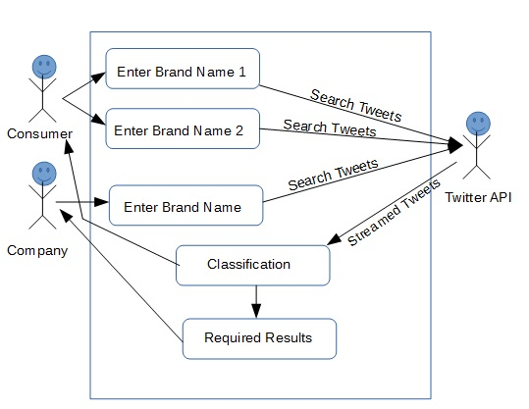
Use Case Diagram

Slide 7
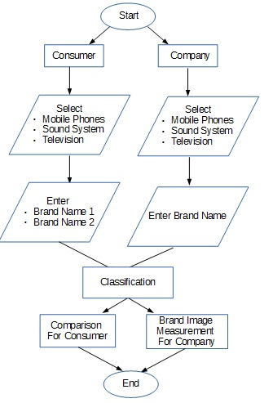
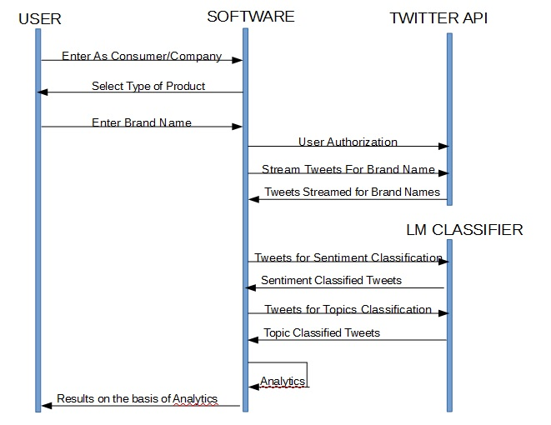
Control Flow Diagram
Sequence Diagram

Slide 8
Implementation Details
In this project, Sentiment and Topic Classifications are implemented using an in build JAVA class “LMClassifier”. An LMClassifier performs joint probability-based classification of character sequences into non-overlapping categories based on language models for each category and a multivariate distribution over categories.
The conditional probability estimate of the category given the input is derived from the joint probability of category and input: P(category input) = P(category, input) / P(input) where the joint probability P(category, input) is determined by the joint probability estimate and the input probability P(input) is estimated by marginalization:
P(input) = Σ_{category} P(category, input)
This classification is done with the help of some 1000 hand-classified tweets. The topics are defined as folder name in classification folder.

Slide 9
Implementation Details
Also, the comparison between the products is carried out using Polarity of Negative, Positive and Neutral tweets using the formula:
if(#Positive_Tweets==0 && #Negative_Tweets==0) Polarity(topic) = #Neutral_Tweets
else if(#Positive_Tweets > #Negative_Tweets && #Negative_Tweets!=0) Polarity(topic) = #Positive_Tweets/
(#Neutral_Tweets + #Negative_Tweets)
else if(#Positive_Tweets > #Negative_Tweets && #Negative_Tweets==0) Polarity(topic) = #Positive_Tweets
else if(#Positive_Tweets < #Negative_Tweets && #Positive_Tweets!=0) Polarity(topic) =-1*#Negative_Tweets/
(#Neutral_Tweets +#Positive_Tweets))
else if(#Positive_Tweets < #Negative_Tweets && #Positive_Tweets==0) Polarity(topic) =-1* #Negative_Tweets

Slide 10
Implementation Details
The net polarity is calculated as the mean of above polarities for different topics under which brand is classified.
Net_Polarity_of_Topic= Σ Polarity(Topic)
#Total_Topics

Slide 11
Conclusion
Microblogging nowadays became one of the major types of the communication. It is identified as online word-of-mouth branding. The large amount of information contained in microblogging web-sites makes them an attractive source of data for opinion mining and sentiment analysis. There are several implications of this project.
These tweets proved as a useful tool for making a comparison tool on real life experiences of people. Also, it proved to be an attractive tool for companies to help them understand their brand image. Microblogging can be used to provide information and draw potential customers to other online media, such as Websites and blogs.

Slide 12
Future Work
Many research questions remain open for future work:
Improve the overall performance of our approach by taking different features and a larger training set into account.
Monitoring and Leveraging micro-blogging sites concerning one’s own brand and the brand of competitors provides valuable competitive intelligent information.
Companies can track micro-blog postings and immediately intervene with unsatisfied customers.
Companies can get near real-time feedback, by setting up corporate accounts, from customers using micro-blog polls, and surveys.

Slide 13
Thank You!

